Slide 1
Efficient Approaches for Data Augmentation by Using Generative Adversarial Network
Faculty 2: Computer Science and Engineering
A thesis submitted in fulfillment of the requirements
for the degree of Master of Engineering (M. Eng.)
in the
Information Technology (M.Eng.)
Supervisor:
Prof. Dr. Doina LOGOFATU
Prof. Dr. Eicke GODEHARDT
Presented by: Pretom Kumar Saha Matrikal No: 1276545 (saha@stud.fra-uas.de)
Notes:
Good morning, Thank you for giving me the opportunity to present my master’s thesis in titled “Efficient Approaches for Data Augmentation by Using Generative Adversarial Network”

Slide 2
Overview
Introduction
Motivation
Problem Statement
Research Question
Literature Overview
Neural Networks
Artificial Neurons
Feedforward Neural Networks
Optimizing Neural Networks
Batch Normalization
Activation Functions
Convolutional Neural Networks
Data Augmentation
Generative Adversarial Network
Uses of GAN
Generator
Discriminator
Loss Function
Training
Experiment and Result Evaluation
Conclusion and Future work
Notes:
Overview
This are the quick overview of my thesis which I am going to present in details today.
In introduction I will explain the motive, problem statements and research question that’s are related to my thesis.
In literature overview section, I will try to represent all the basics related to GAN from scratch. Which are
Neural Networks
Artificial Neurons
Feedforward Neural Networks
Optimizing Neural Networks
Batch Normalization
Activation Functions
Convolutional Neural Networks
The next section Data Augmentation will represent all the Augmented techniques which are available.
The most important parts is the GAN. I will give an overview about
Uses of GAN
Generator
Discriminator
Loss Function
Training
The experiment I have performed in my thesis will be presented with performance result in Experiment and Result Evaluation.
At the End I will present the summary and some idea of work on which future works are possible in Conclusion and Future work parts.

Slide 3
Introduction
Generative Adversarial Networks (GANs) by Ian Goodfellow in 2014
For implementing and testing applications required a large amount of different fields data.
Highly cost-consuming in terms of money, time, staffing, and applications.
The way of data organizing Structured, Semi-structured, and Unstructured.
Data cleansing takes up to 60% of data scientist's work.
Generate "fake" or synthesized data.
Notes:
Introduction
Generative Adversarial Networks (GANs) are a class of machine learning frameworks introduced by Ian Goodfellow in 2014.
To introduce this GAN there has some basic idea behind this. In the world of data to aggregate a large amount of different fields data for implementing and testing applications.
To collect this data , store them and do some analyses on them Highly cost-consuming in terms of money, time, staffing, and applications.
If we think on the way of data organizing like Structured, Semi-structured, and Unstructured have different characteristics and process of handling data which are different.
On the other hand, only on Data cleansing takes up to 60% of data scientist's work.
So the most suitable solution is Generate "fake" or synthesized data. And GAN is one of the suitable tool for Generating "fake“ data.

Slide 4
Motivation
Introduction
more practical challenges and verify newly established techniques.
Data privacy.
Storage, processing, and analysis of data as layers of Big data.
Large data storage systems require adequate and trustworthy interfaces.
Notes:
There has some essential motivation behind this GAN.
More practical challenges and verify newly established techniques.
Data privacy .
Storage, processing, and analysis of data as layers of Big data.
Large data storage systems require adequate and trustworthy interfaces.
Reduce all of this issue GAN can be one of the effective solution.

Slide 5
Problem Statement
Introduction
Generate synthesized tabular form given Dataset. The selection of a suitable GAN model is one of the biggest challenges in the thesis.
Train a GAN model with generator and discriminator neuron. Find out suitable hyper-parameter values for the GAN model.
Select a more appreciated optimizer for the GAN model.
Visualized and analyzed the performance of the model.
Notes:
In this thesis I have faced lot of difficulties. And I also work on those difficulties throw my thesis. Here The most important issues are presented.
Generate synthesized tabular form given Dataset. The selection of a suitable GAN model is one of the biggest challenges in the thesis.
Train a GAN model with generator and discriminator neuron. Find out suitable hyper-parameter values for the GAN model.
Select a more appreciated optimizer for the GAN model.
Visualized and analyzed the performance of the model.

Slide 6
Research Question
Introduction
RQ_1: What is the basic structure of the GAN model with Generator and Discriminator neurons?
RQ_2: What is the importance of the Activation function, Batch normalization, optimizer, and CNN in GAN?
RQ_3: What is Data Augmentation, and what is the present situation of Data Augmentation in different data fields?
RQ_4: How does the model perform with different data sets and features, including the success of data generation compared with original data?
RQ_5: What are the limitations and future work can be for the GAN model with respect to tabular data?
Notes:
My thesis work try to explain the answer of this question.
RQ_1: What is the basic structure of the GAN model with Generator and Discriminator neurons?
RQ_2: What is the importance of the Activation function, Batch normalization, optimizer, and CNN in GAN?
RQ_3: What is Data Augmentation, and what is the present situation of Data Augmentation in different data fields?
RQ_4: How does the model perform with different data sets and features, including the success of data generation compared with original data?
RQ_5: What are the limitations and future work can be for the GAN model with respect to tabular data?

Slide 7
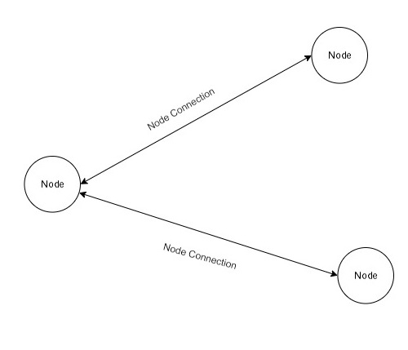
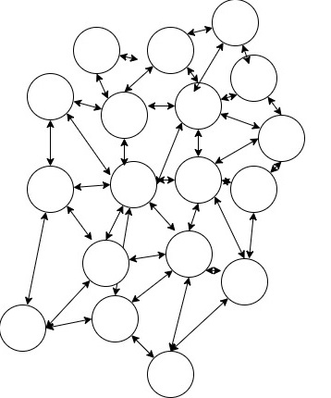
Literature Overview
Neural Networks
A collection of nodes.
A collection of nodes connections.
Simple Network
Node
Node connection
Node
Neural Net
Complex Network
Notes:
Neural Networks
This is the core of everything. In simple form it’s a collection of nodes and collection of nodes connections. If there is two node and one connection then its called neural net and if there has more then one connection then it’s a network. This are the example of simple and complex network.

Slide 8
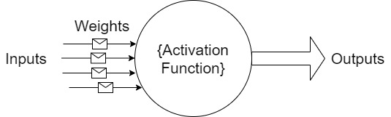
Literature Overview
Artificial Neurons
inputs (such as synapses)
Weights (signal intensity)
A mathematical function that determines the neuron’s activity
Notes:
Artificial Neurons
If we update into the next level is artificial neurons. This is similar as the neural network . But the progress is that It can work like the neuron in human brain. The inputs are like synapses and weights are like signal intensity. A mathematical function is used to determines the neuron’s activity.

Slide 9
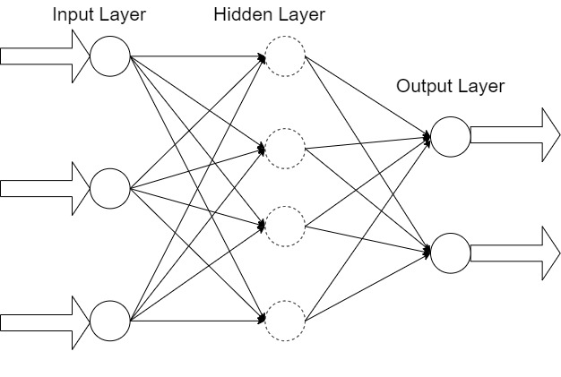
Literature Overview
Feedforward Neural Networks
An input layer
An output layer
Hidden layers
The input layer output signals are fed into the next layer
No "feedback" from the neurons’ outputs to the inputs
Notes:
Feedforward Neural Networks
Now we are going to connect those artificial neurons in layer. Initially, there has two layer input and out put layer its it’s a 2 layer network. If there has more then two layer then the middle layer is called hidden layer. There can be more then one hidden layer depend on the network. If The input layer output signals are fed into the next layer and No "feedback" from the neurons’ outputs to the inputs then the network is called Feedforward Neural Networks.
So its always in forward direction.

Slide 10






Literature Overview
Optimizing Neural Networks
Find the best parameter (weight).
Depending on the expected output and input data, the values of the parameters will be changed.
Gradient Descent
Adaptive Learning Rate Optimizers
Adagrad
RMSProp
Adam
Notes:
Optimizing Neural Networks
Now we are looking for the mathematical parts. From The first equation
We see that
Alfa is the output , x is the input . W represent weight and delta is the activation faction with bias b.
In output we will get the best result if we find the best weight for the neuron. And Depending on the expected output and input data, the values of the parameters will be changed. Different types of optimization procedure are used.
One of the powerful optimization algorithms is Gradient descent, and it is by far the most frequent method of optimizing neural networks. Gradient descent is a first-order iterative optimization algorithm for finding a local minimum of a differentiable function. The learning rate find out the size of the steps it takes to achieve a (local) minimum.
It is challenging to use learning rate schedules because their hyperparameters must be established in advance. be replaced with adaptive gradient descent algorithms like RMSprop, Adam, Adagrad, and Adadelta can solve this issue.
Adagrad
Adagrad is a gradient-based optimization method. Thus, sparse data may be handled with ease because of its flexibility and adaptability.
RMSProp changes the matrix G from the Adagrad update. Lessen the aggressive, monotonically declining learning rates.
Adaptive Moment Estimation (Adam) .The method’s name is derived from estimations of the gradients’ first and second moments,

Slide 11



Literature Overview
Batch Normalization
A pre-processing procedure for numerical data
A similar scale without altering its form
A method for increasing the speed and stability of a deep neural network
The normalizing procedure also occurs in batches
Notes:
Batch Normalization
Normalization is a pre-processing procedure for numerical data to bring it to a similar scale without altering its form.
Batch normalization is a method for increasing the speed and stability of a deep neural network by adding more layers.
In batch normalization, the normalizing procedure also occurs in batches rather than as a single input.
Layer h has a total of m neurons
Once the concealed activations have been calculated, the standard deviation will be determined.
To prevent division by zero, the smoothing term (e) ensures numerical stability inside the operation.

Slide 12
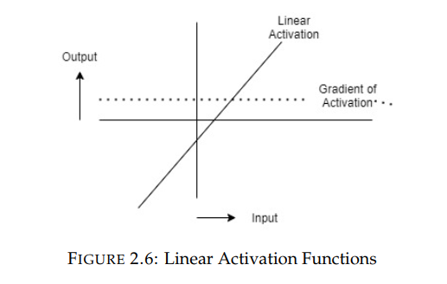
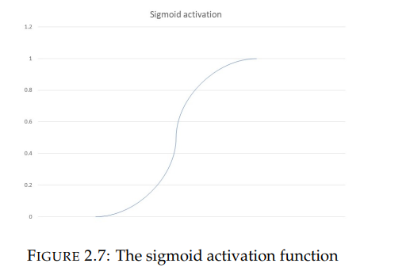
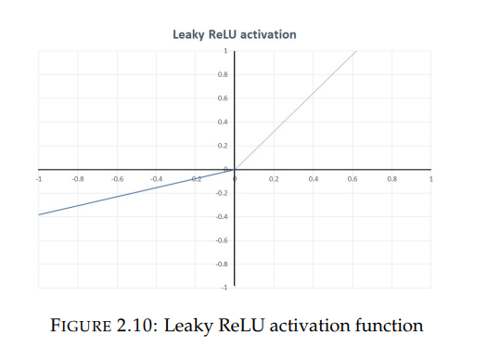
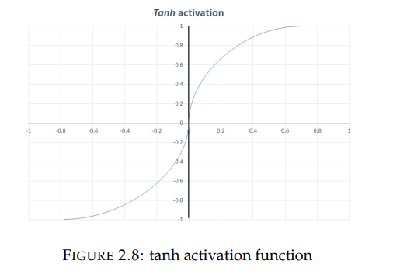
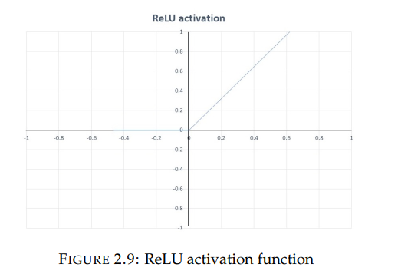
Literature Overview
Activation Functions
An incoming value exceeds a critical threshold
Notes:
Activation Functions
An activation function is like a gate that checks whether an incoming value exceeds a critical threshold.
Linear Activation create a linear form of graph. In figure 2.6
Sigmoid gives a value between [0, 1]. Figure 2.7
The tanh function’s parameter range is from (-1 to 1) Figure 2.8
ReLU When y is less than zero, f(y) is zero, and when y is more than or equal to zero, f(y) is equal to y Figure 2.9
LReLU The leak contributes to the ReLU function’s increased range. The value of an is usually around 0.01 Figure 2.10

Slide 13
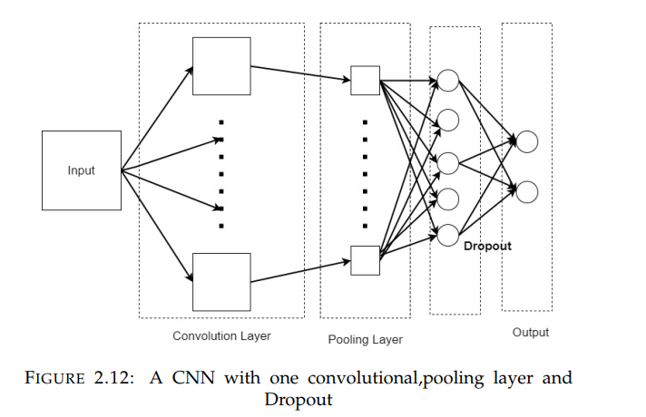
Literature Overview
Convolutional Neural Networks
The most commonly utilized ML techniques.
Utilized for feature creation and classification
Does not need manual extraction of features
The sharing of weight
Dimensionality decrease by downsampling
Notes:
Convolutional Neural Networks
CNN is the most commonly utilized ML techniques.
Its Utilized for feature creation and classification of data.
Does not need manual extraction of features. It can extract data values form any input.
Its share the weight values. Dimensionality decrease by downsampling.
Each neuron works as a kernel in the convolutional layer, which is made up of convolutional kernels. Convolution becomes a correlation operation when the kernel is
Symmetric.
The pooling layer downsamples the convolved features nonlinearly. a pooling process causes the input to be divided into several rectangular patches.
By putting hidden units values to zero, dropout layers randomly exclude.

Slide 14
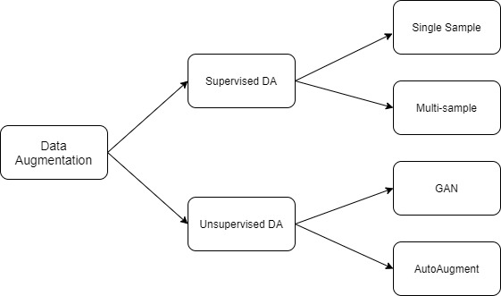
Data Augmentation
Image Data Augmentation
Text Data Augmentation
Speech Data Augmentation
Tabular Data Augmentation
GANs:
RGAN and RCGAN
medGAN , corrGAN , and numerous enhanced models
ehrGAN
Notes:
"Data Augmentation" (DA) refers to techniques for expanding the variety of training data without gathering any extra data. In normal version to create a bunch of new data similar like input data.
In the fugure we can see
There are two types of Supervised data augmentation: single sample and multi-sample .
unsupervised data in two different ways. Data distribution may be learned by models.
Another option is to use the model to learn a data improvement strategy .
The most popular cases the data augmentation are using is
Image Data Augmentation
Text Data Augmentation
Speech Data Augmentation
Tabular Data Augmentation
Image Data Augmentation Flipping, Rotation, Translation, Cropping, and Scaling, as well as color space are very common.
Text Data Augmentation Symbolic augmentation, Rule based augmentation, MixUp augmentation and so on.
Speech Data Augmentation Time warping, frequency masking, and time masking are the three most used methods
Tabular Data Augmentation has some smiller way of data augmentation like Transformation , Mapping, Extraction.
But we are taking about machine learning way of DA. ´Which is called GAN.
Real-valued time-series data may be generated using RGAN and RCGAN.
medGAN , corrGAN , and numerous enhanced models can create discrete medical records but not continuous.
ehrGAN creates enhanced medical records but does not create synthetic data.

Slide 15
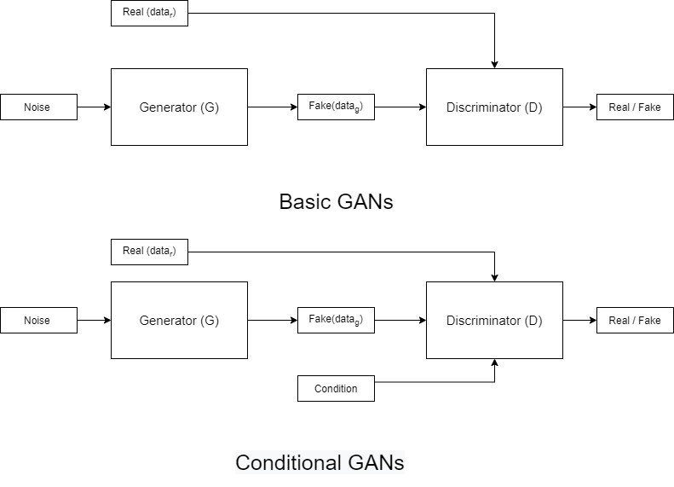
Generative Adversarial Network
They are made up of two ’adversarial’ models:
a generative model G that captures the data distribution
a discriminative model D that assesses the likelihood that a sample originated from the training data rather than G.
Notes:
the generative adversarial network (GAN) are made up of two ’adversarial’ models:
a generative model G that captures the data distribution
a discriminative model D that assesses the likelihood that a sample originated from the training data rather than G
The process of GANs is as a game. GANs have two parts, one is the generator, and the second is the discriminator. They play against each other to win the game.
The pictures shows one is the basic gan Architecture and other one is conditional gan.
When we put same noise in the generator its create the fake data. And the discriminator compare the fake data with the real data. The process continue until the generator can produce the fake data which is almost similar like real data.

Slide 16

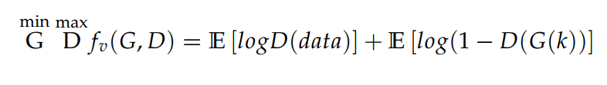

Generative Adversarial Network
A two-player min-max game with value function
Fake Sample
Genuine Sample
A two-player min-max game with value function with condition y
Notes:
In mathematical equation its A two-player min-max game.
In the equation first part represent Genuine sample and the second part represent the fake sample.
If we introduce some condition y in GAN framework then the equation will be like .

Slide 17
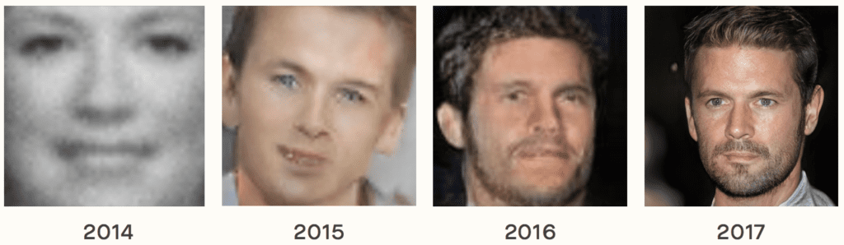
Uses of GAN
Generative Adversarial Network
Generate Examples for Image Datasets
Generate Photographs of Human Faces
Generate Realistic Photographs
Generate Cartoon Characters
Image-to-Image Translation
Text-to-Image Translation
Notes:
GAN are successfully used and developed in such cases like
Generate Examples for Image Datasets
Generate Photographs of Human Faces
Generate Realistic Photographs
Generate Cartoon Characters
Image-to-Image Translation
Text-to-Image Translation
And so on.
Here is an example of output of gan. Year by year its get more and more accuracy in human face genarations.

Slide 18
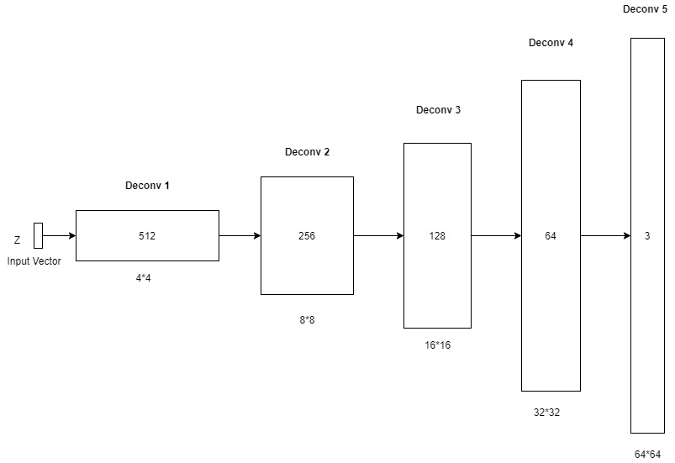
Generator:
Generative Adversarial Network
Fake Sample
G to minimize {E [log(1 − D(G(k))]}
Notes:
Generator to minimize log(1 - D(G(k)) the fake samole
There are many deconvolutional layers in the generator G, which makes it a neural network as well. The discriminator’s procedure is reversed when G is involved. The input z is transformed into a 2-dimensional
matrix, corresponding to a synthetic table row, using several de-convolutional layers. A convolution block is created by reshaping this representation (4*4*512) to an output (64*64*3).

Slide 19
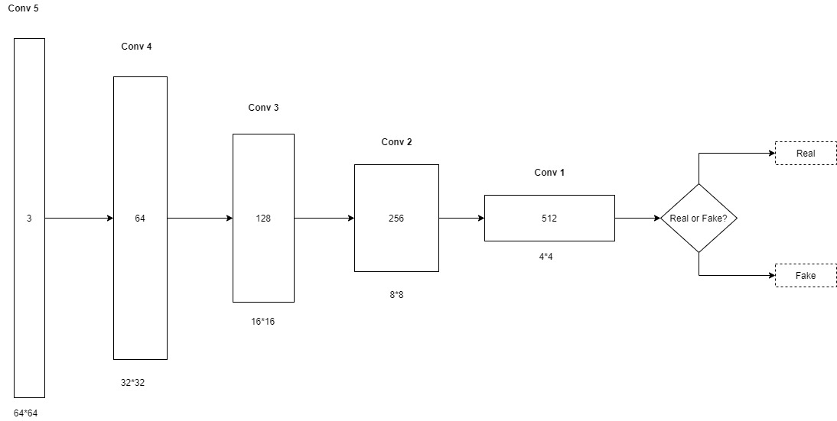
Discriminator:
Generative Adversarial Network
max D {fv(G, D) = E [logD(data)]}
Genuine Sample
Notes:
Discriminator is maximized the logD(data) genuine sample.
Discriminator is a convolutional neural network (CNN) with many layers. In each layer, the whole input matrix is subjected to a set of trainable filters. the records are transformed into square matrices[34]. As a result, the output layer
size is inversely proportional to the number of filters included inside it.

Slide 20
Loss Function:
Generative Adversarial Network
Training neural networks
Minimizing a loss function
Three loss functions
To begin with the initial loss
An information loss
Classification loss
Notes:
Training neural networks are based on the loss function. In general, neural networks are taught by minimizing a loss function. The choice of loss functions for training the three suggested neural networks is critical to the success of table syntheses.
To begin with the initial loss An information loss
Classification loss

Slide 21


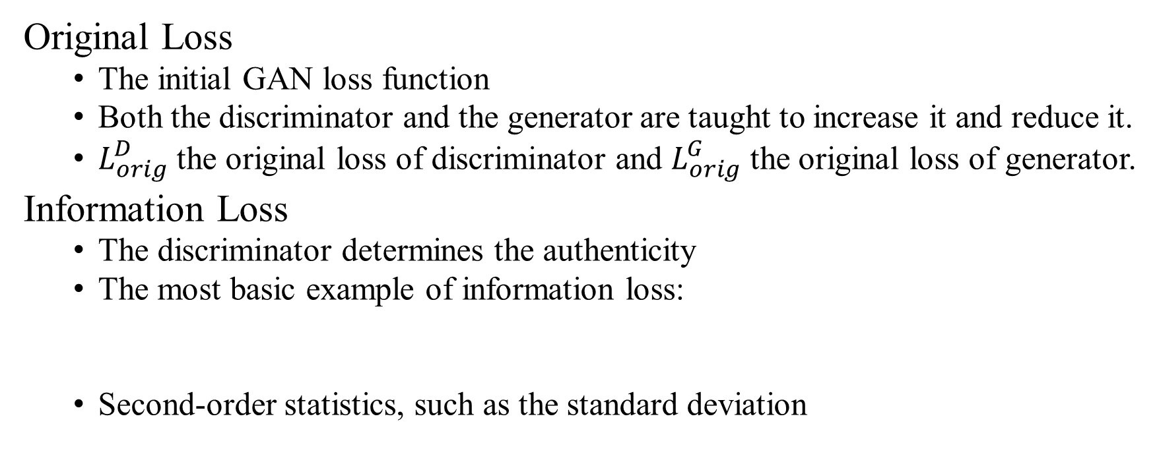
Loss Function:
Generative Adversarial Network
Original Loss
The initial GAN loss function
Both the discriminator and the generator are taught to increase it and reduce it.
$L_{orig}^{D}$ the original loss of discriminator and $L_{orig}^{G}$ the original loss of generator.
Information Loss
The discriminator determines the authenticity
The most basic example of information loss:
Second-order statistics, such as the standard deviation
Notes:
Original Loss is
The initial GAN loss function means the difference between the input and output data.
Both the discriminator and the generator are taught to increase it and reduce it.
$L_{orig}^{D}$ the original loss of discriminator and $L_{orig}^{G}$ the original loss of generator.
Information Loss
The discriminator determines the authenticity of the inputs based on those features to measure information loss.
The following is the most basic example of information loss:
E [fx] represents the dataset’s average feature
Second-order statistics, such as the standard deviation Standard deviation (SD) is defined SD

Slide 22

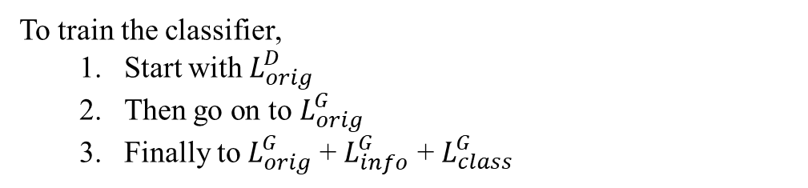
Generative Adversarial Network
Loss Function:
Loss to train the generator:
Classification Loss
Another loss function:
To train the classifier,
Start with $L_{orig}^{D}$
Then go on to $L_{orig}^{G}$
Finally to $L_{orig}^{G}$ + $L_{info}^{G}$ + $L_{class}^{G}$
Notes:
the following loss to train the generator which used both the average and standard deviation.
Classification Loss
Values in synthetic records don’t always line up with labels. Classification loss as LC is another loss function to prevent this problem.
l() and rmv() are function that returns and removes the label attribute from an input record, where as C() is the label predicted by the classifier neural network.
To train the classifier,
Start with discrimanator loss
Then go on to the ganarator loss
Finally to original genrarot loss + info loss + class loss for genrator

Slide 23


Training:
Generative Adversarial Network
Discriminator
A mini-batch of real sample $data=\left\{{data}_{1},{data}_{2},………{data}_{n}\right\}$
A set of latent vector inputs $k=\left\{k_{1},k_{2},………k_{n}\right\}$
Update Discriminator D:
Notes:
In the training section the Discriminator parts start with A mini-batch of real sample $data$
And A set of latent vector inputs k
The following equation is used to update the D.

Slide 24

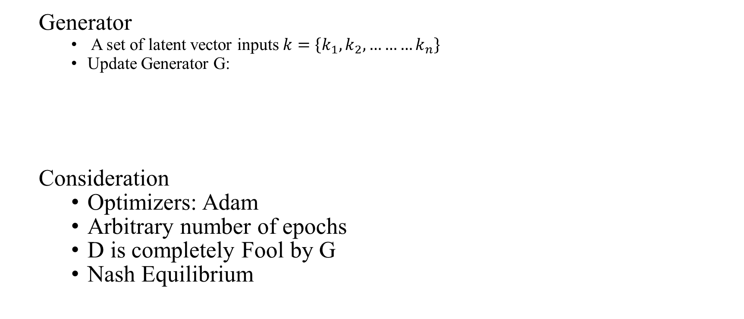
Training:
Generative Adversarial Network
Generator
A set of latent vector inputs $k=\left\{k_{1},k_{2},………k_{n}\right\}$
Update Generator G:
Consideration
Optimizers: Adam
Arbitrary number of epochs
D is completely Fool by G
Nash Equilibrium
Notes:
On the other hand the Generator parts start with A set of latent vector inputs k
The following equation is used to update the G.
In special consideration adam is used as optimizer, an Arbitrary number of epochs to train when D is completely fooled by G.
And the goal is to reach a Nash Equilibrium when D can do the best random guessing.

Slide 25
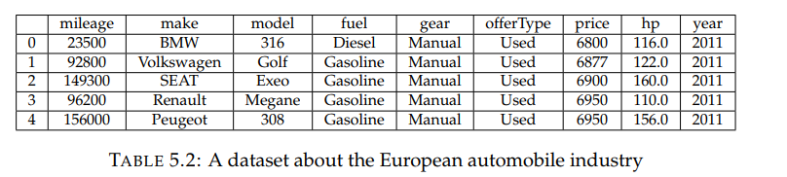
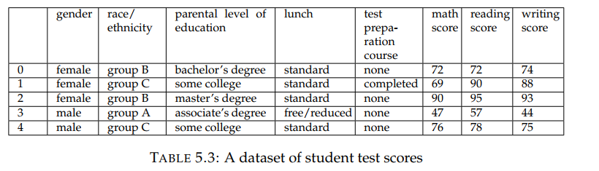
Experiment and Result Evaluation
Dataset
Category and Numerical data
Two different dataset.
A dataset about the European automobile industry
Student test scores
Notes:
Dataset
I tried to perform The GAN model in two separate data set to understand the performance. As I am implementing both Category and Numerical data.
First table represent
A dataset about the European automobile industry
And 2nd one is
Student test scores
Both the data set I collected form Kaggle .

Slide 26
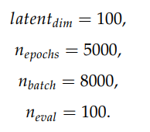
Experiment and Result Evaluation
Data Analysis
Data Cleaning
Data Inspection
Data Transforming
Data Normalization
TGAN Model Setup
Choose specific hyperparameters
Notes:
The first important think as an initial stapes is Data analysis.
Data Cleaning : clean and remove unnecessary data.
Data Inspection: Is the data set has some missing value or not.
Data Transforming: If there has some categorical data the convert them into numerical form using binary encoder.
Data Normalization: normalizing is on of the important part for calculation and to get best and qualified output.
The initial step in the model setup is to choose specific hyperparameters for the model. I fixed the hyperparameter as follows:
latentdim = 100
epochs = 5000
batch = 8000
eval = 100.

Slide 27
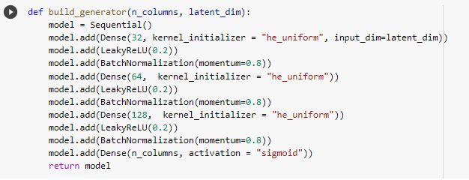
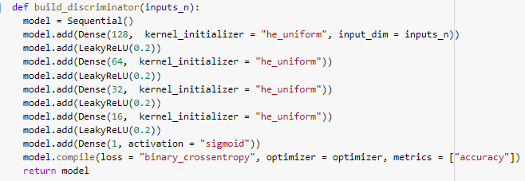
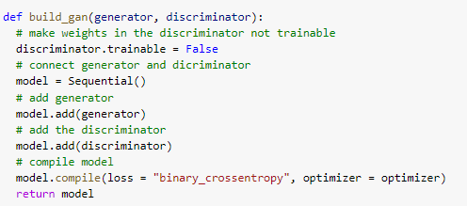
Experiment and Result Evaluation
Build generator model
Define optimizer
optimizer = Adam(lr=0.0002, beta_1=0.5)
Build Discriminator model
Build GAN
Train GAN
train(gan, generator, discriminator, scaleNumData, latent_dim, n_epochs = 5000, n_batch = 8000, n_eval = 100)
Notes:
The model start with building up the generator. The first snap reparent the generator building function.
Then initialize the optimizer. I previously mention that we are using adam optimiser.
The next is to build the Discrimanator model. 2nd sanp represent the discriminator building function.
Finaly we need to builed the gan model . The last snap repesntion the GAN function. Now. If we train the gan using the selected hyperparameter it will takes 30/40 min to generate synthesis data with accuracy.

Slide 28
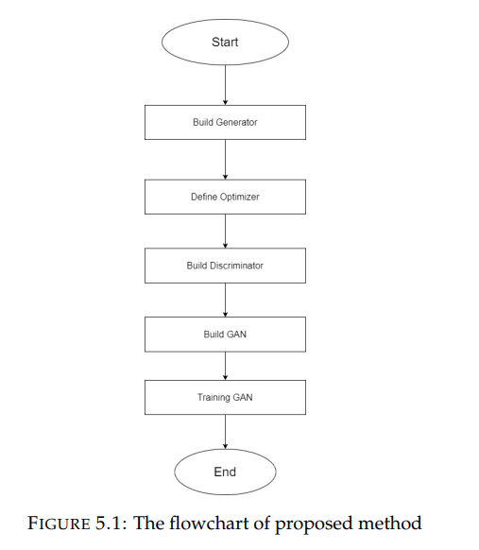
Experiment and Result Evaluation
Notes:
This is the flow diagram of the model.

Slide 29
Experiment and Result Evaluation
Performance Analysis
Three different set of experiments.
Numerical data
Categorical data
Numerical and Categorical data.
Notes:
Performance Analysis
We separated our task in three different section .
Numerical data section
Categorical data section
Numerical and Categorical data section

Slide 30
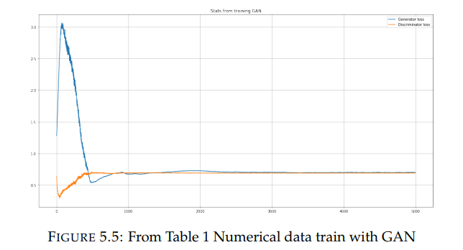
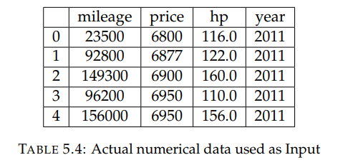
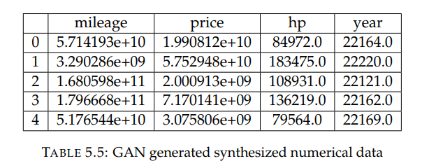
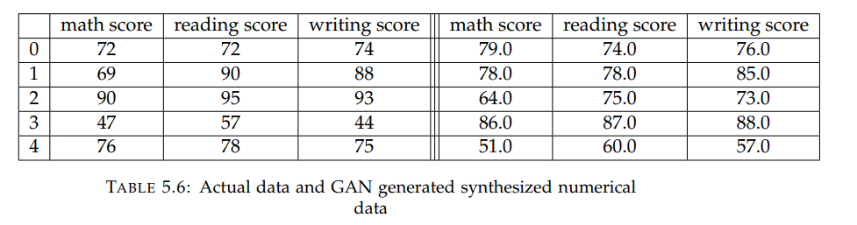
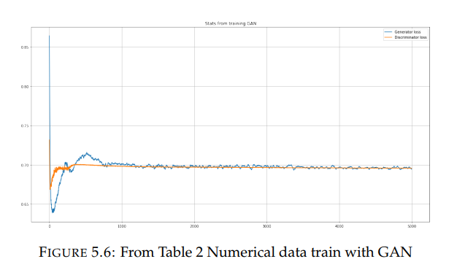
Experiment and Result Evaluation
Numerical data
Notes:
If we saw numerical value for automobile data set we can see the output is not to close to the input table. Because of insufficient iteration.
But if we see the student score data set we can say that model successfully generated the fake data. The graps show the flow of generato and discriminator loss. At the end they both are coming into tha nash equlibariam points.

Slide 31
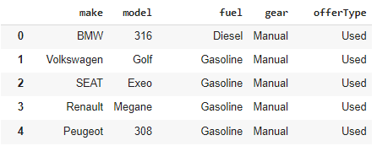
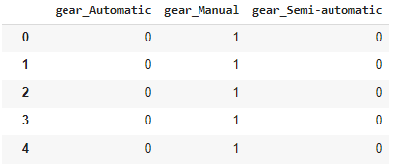
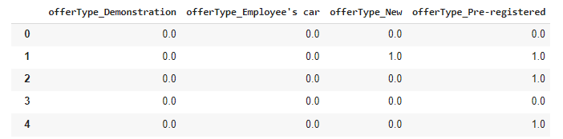
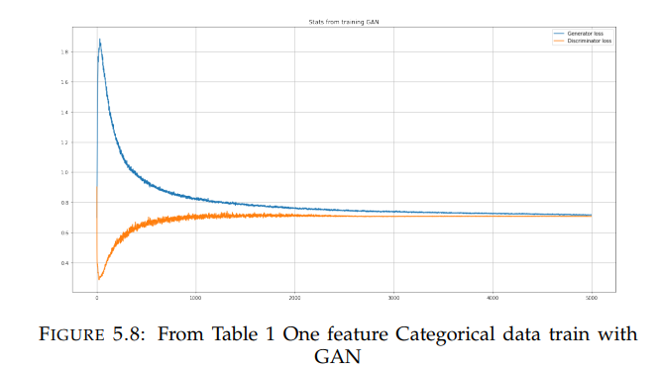
Experiment and Result Evaluation
Categorical data
Notes:
Samilerly if we look on the categorical data . As we transform the categorical data to binary encoding its create features of data depending on the unique value with 0 and 1.
And we also get some successful result as we can see on the tables and graph. This is for the automobile dataset.

Slide 32
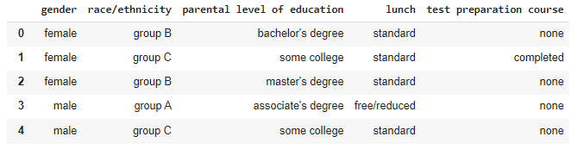
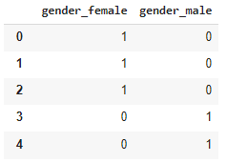
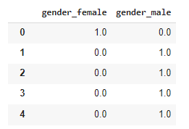
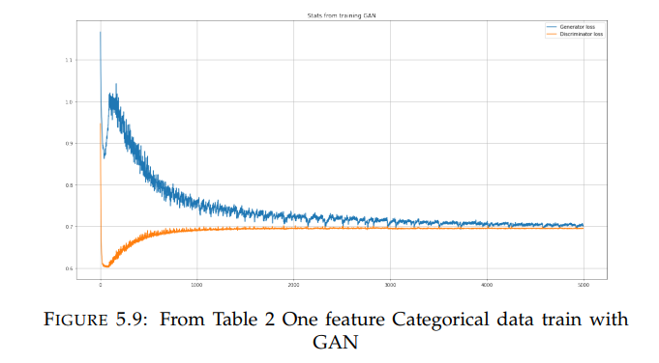
Experiment and Result Evaluation
Categorical data
Notes:
And this one for the student score points data set

Slide 33
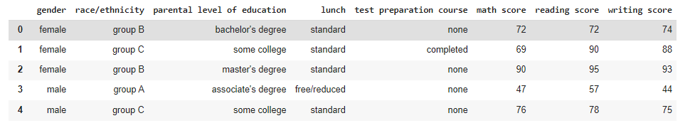
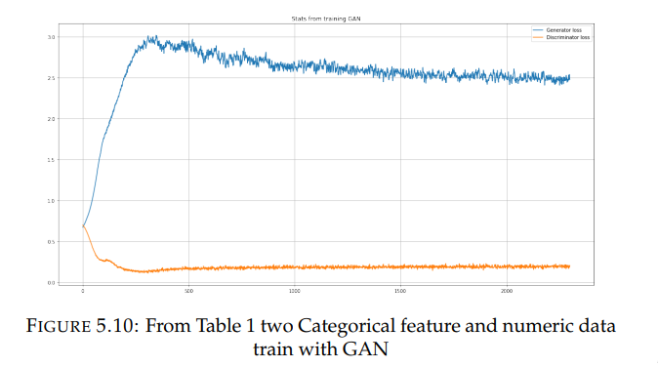
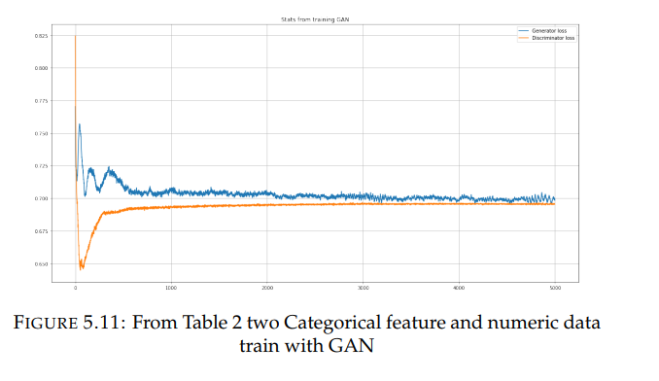
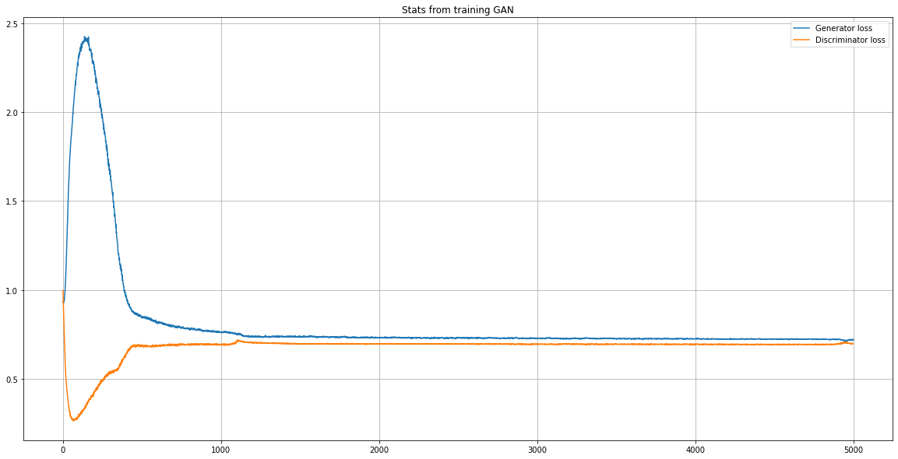
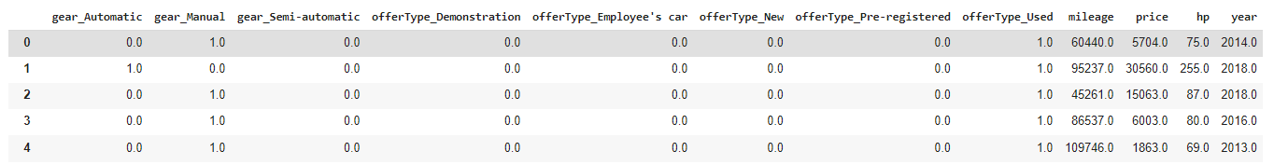
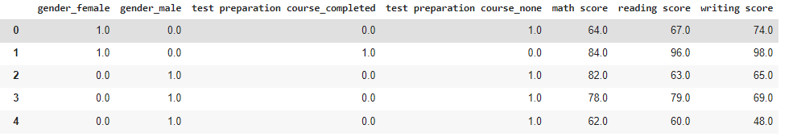
Experiment and Result Evaluation
Numerical and Categorical data
Figure: From Table 1 categorical and numerical value
Notes:
Now we combine the both Numerical and Categorical data. When we select those categorical data has lot of unique vale we saw that that time model work very badly as you see on figure 5.10.
Otherwise, with small number of catagorical date and neumarical data perfoming very well as you can see the outputs.

Slide 34
Conclusion and Future work
Conclusion:
A beneficial and potent technique.
GANs are extensively employed in image data augmentation
Image augmentation is more straightforward than tabular data augmentation
Production of high-quality tabular data in real-time, based on specified characteristics
Collection and analysis of any size dataset
Numeric and categorical data are processed successfully.
supporting a single table with both numerical and categorical data elements
relational databases is widespread, yet modeling them was very challenging
Notes:
In Conclusion
We can say thet gan is a beneficial and potent technique.
As we know GANs are extensively employed in image data augmentation.
Image augmentation is more straightforward than tabular data augmentation.
Our model is capable of
Production of high-quality tabular data in real-time, based on specified characteristics
Collection and analysis of any size dataset
Numeric and categorical data processed successfully.
Model can supporting a single table with both numerical and categorical data elements
And
relational databases is widespread, yet modeling them was very challenging

Slide 35
Conclusion and Future work
Future work
Choosing hyper-parameters model in GAN for any dataset
Introduce a new Table-GAN which can handle multiple table data
Training data so they are related to the model selection task
A considerable impact on the model’s performance, by finding optimal values
Notes:
Future works are
Choosing hyper-parameters model in GAN for any dataset
Introduce a new Table-GAN which can handle multiple table data
Training data so they are related to the model selection task
A considerable impact on the model’s performance, by finding optimal values

Slide 36
Bibliography
David E. Rumelhart and James L. McClelland. “Learning Internal Representations by Error Propagation”. In: Parallel Distributed Processing: Explorations in the Microstructure of Cognition: Foundations. 1987, pp. 318–362.
Thomas H. Davenport and Laurence Prusak. Working Knowledge: How Organizations Manage What They Know. Harvard Business School Press, Jan. 1992.
J. E. Dennis and Robert B. Schnabel. Numerical Methods for Unconstrained Optimization and Nonlinear Equations. Classics in Applied Mathematics. Society for Industrial and Applied Mathematics, Jan. 1996. ISBN: 9780898713640. DOI: 10.1137/1.9781611971200. URL: https://epubs.siam.org/doi/book/10. 1137/1.9781611971200 (visited on 11/03/2021).
Daniel Svozil, Vladimír Kvasnicka, and Jirí Pospichal. “Introduction to multilayer feed-forward neural networks”. In: Chemometrics and Intelligent Laboratory Systems 39.1 (1997), pp. 43–62. ISSN: 0169-7439. DOI: https://doi.org/10.1016/S0169-7439(97)00061-0. URL: https://www.sciencedirect.com/science/article/pii/S0169743997000610.
S.S. Haykin. Neural Networks: A Comprehensive Foundation. International edition. Prentice Hall, 1999. ISBN: 9780139083853. URL: https://books.google. de/books?id=M5abQgAACAAJ.
Balázs Csanád Csáji. “Approximation with Artificial Neural Networks”. MA thesis. Eindhoven University of Technology, June 2001.
Carlos Gershenson. “Artificial Neural Networks for Beginners”. In: CoRR cs.NE/0308031 (2003). URL: http://arxiv.org/abs/cs/0308031.
Ajith Abraham. “Artificial Neural Networks”. In: Handbook of Measuring System Design. American Cancer Society, 2005. Chap. 129. ISBN: 9780471497394. DOI: https : / / doi . org / 10 . 1002 / 0471497398 . mm421. eprint: https : / /onlinelibrary . wiley . com / doi / pdf / 10 . 1002 / 0471497398 . mm421. URL:https://onlinelibrary.wiley.com/doi/abs/10.1002/0471497398.mm421.
Murat Hüsnü Sazli. “A brief review of feed-forward neural networks”. In:2006, pp. 11–17.
Ludovic Arnold et al. “An Introduction to Deep Learning”. In: European Symposium on Artificial Neural Networks (ESANN). Proceedings of the European Symposium on Artificial Neural Networks (ESANN). Bruges, Belgium, Apr. 2011. URL: https://hal.archives-ouvertes.fr/hal-01352061.
Léon Bottou. “Stochastic Gradient Descent Tricks”. In: Neural Networks: Tricks of the Trade: Second Edition. Ed. by Grégoire Montavon, Geneviève B. Orr, and Klaus-Robert Müller. Berlin, Heidelberg: Springer Berlin Heidelberg, 2012, pp. 421–436. ISBN: 978-3-642-35289-8. DOI: 10.1007/978- 3- 642- 35289- 8_25. URL:https://doi.org/10.1007/978-3-642-35289-8_25.
Srivastava N. Hinton G. and K. Swersky. “Lecture 6a: Overview of minibatch gradient descent.” In: COURSERA: Neural Networks for Machine Learning. 2012.
Diederik P Kingma and Max Welling. “Auto-Encoding Variational Bayes”. In: arXiv:1312.6114 (Dec. 2013).
L. Deng and D. Yu. Deep Learning: Methods and Applications. Foundations and trends in signal processing. Now Publishers, 2014. ISBN: 9781601988140. URL: https://books.google.de/books?id=46qNoAEACAAJ.
Ian J. Goodfellow et al. “Generative Adversarial Nets”. In: Machine Learning (June 2014). URL: https://arxiv.org/abs/1406.2661v1.

Slide 37
Bibliography
Mehdi Mirza and Simon Osindero. “Conditional Generative Adversarial Nets”. In: CoRR abs/1411.1784 (2014). arXiv: 1411.1784. URL: http://arxiv.org/abs/1411.1784.
Jon Gauthier. “Conditional generative adversarial nets for convolutional face generation”. en. In: (2015).
Alireza Makhzani et al. “Adversarial Autoencoders”. In: CoRR abs/1511.05644 (2015). arXiv: 1511.05644. URL: http://arxiv.org/abs/1511.05644.
James Martens and Roger B. Grosse. “Optimizing Neural Networks with Kronecker-factored Approximate Curvature”. In: CoRR abs/1503.05671 (2015). arXiv: 1503.05671. URL: http://arxiv.org/abs/1503.05671.
Jürgen Umbrich, Sebastian Neumaier, and Axel Polleres. “Quality Assessment and Evolution of Open Data Portals”. In: 2015 3rd International Conference on Future Internet of Things and Cloud. Aug. 2015, pp. 404–411. DOI: 10 . 1109 /FiCloud.2015.82.
LeCun Y, Bengio Y, and Hinton G. “Deep learning”. In: Nature 521 (2015), 436–444. DOI: 10.1038/nature14539. URL: https://pubmed.ncbi.nlm.nih.gov/26017442/.
An overview of gradient descent optimization algorithms. en. Jan. 2016. URL: https://ruder.io/optimizing-gradient-descent/ (visited on 11/08/2021).
Sebastian Ruder. “An overview of gradient descent optimization algorithms”.In: CoRR abs/1609.04747 (2016). arXiv: 1609.04747. URL: http://arxiv.org/abs/1609.04747.
Francesco Calimeri et al. “Biomedical Data Augmentation Using Generative Adversarial Neural Networks”. In: Artificial Neural Networks and Machine Learning – ICANN 2017. Cham: Springer International Publishing, 2017, pp. 626–634. ISBN: 978-3-319-68612-7.
Francesco Calimeri et al. “Biomedical Data Augmentation Using Generative Adversarial Neural Networks”. In: Artificial Neural Networks and Machine Learning – ICANN 2017 10614 (2017), pp. 626–634. URL: https://doi.org/10.1007/978-3-319-68612-7_71.
Edward Choi et al. “Generating Multi-label Discrete Patient Records using Generative Adversarial Networks”. In: arXiv:1703.06490 (Mar. 2017).
Antonia Creswell et al. “Generative Adversarial Networks: An Overview”. In:CoRR abs/1710.07035 (2017). arXiv: 1710.07035. URL: http://arxiv.org/abs/1710.07035.
Fabian Gieseke et al. “Convolutional neural networks for transient candidate vetting in large-scale surveys”. In: Monthly Notices of the Royal Astronomical Society 472.3 (2017), 3101–3114. ISSN: 1365-2966. DOI: 10.1093/mnras/stx2161.URL: http://dx.doi.org/10.1093/mnras/stx2161.
Diederik P. Kingma and Jimmy Ba. “Adam: A Method for Stochastic Optimization”. In: (2017). arXiv: 1412.6980 [cs.LG].
Saeed Rouhani, Sayna Rotbei, and Homa Hamidi. “What do we know about the big data researches? A systematic review from 2011 to 2017”. In: Journal of Decision Systems 26.4 (2017), pp. 368–393. DOI: 10.1080/12460125.2018.1437654. URL: https://doi.org/10.1080/12460125.2018.1437654.

Slide 38
Bibliography
Dina Sukhobok, Nikolay Nikolov, and Dumitru Roman. “Tabular Data Anomaly Patterns”. In: 2017 International Conference on Big Data Innovations and Applications (Innovate-Data) (Aug. 2017), pp. 25–34. URL: http://link.aip.org/link/?RSI/69/1236/1.
Christian Huyck and Dainius Kreivenas. “Implementing Rules with Artificial Neurons”. In: Artificial Intelligence XXXV. Ed. by Max Bramer and Miltos Petridis. Cham: Springer International Publishing, 2018, pp. 21–33. ISBN:978-3-030-04191-5.
Thomas Neff. “Data Augmentation in Deep Learning using Generative Adversarial Networks”. MA thesis. Graz University of Technology, Mar. 2018.
Noseong Park et al. “Data synthesis based on generative adversarial networks”. In: Proceedings of the VLDB Endowment 11.10 (2018), 1071–1083. ISSN: 2150-8097. DOI: 10 . 14778 / 3231751 . 3231757. URL: http : / / dx . doi . org / 10 . 14778 /3231751.3231757.
Giorgia Ramponi et al. “T-CGAN: Conditional Generative Adversarial Network for Data Augmentation in Noisy Time Series with Irregular Sampling”. In: CoRR abs/1811.08295 (2018). arXiv: 1811.08295. URL: http://arxiv.org/abs/1811.08295.
Lei Xu and Kalyan Veeramachaneni. “Synthesizing Tabular Data using Generative Adversarial Networks”. In: CoRR abs/1811.11264 (2018). arXiv: 1811.11264. URL: http://arxiv.org/abs/1811.11264.
Sukarna Barua, Sarah Monazam Erfani, and James Bailey. “FCC-GAN: A Fully Connected and Convolutional Net Architecture for GANs”. In: CoRR abs/1905.02417 (2019). arXiv: 1905.02417. URL: http://arxiv.org/abs/1905.02417.
James Jordon, Jinsung Yoon, and Mihaela van der Schaar. “PATE-GAN: Generating Synthetic Data with Differential Privacy Guarantees”. In: 7th International Conference on Learning Representations, ICLR 2019, New Orleans, LA, USA, May 6-9, 2019. OpenReview.net, 2019. URL: https://openreview.net/forum?id=S1zk9iRqF7.
Asifullah Khan et al. “A Survey of the Recent Architectures of Deep Convolutional Neural Networks”. In: CoRR abs/1901.06032 (2019). arXiv: 1901.06032.URL: http://arxiv.org/abs/1901.06032.
Daniel S. Park et al. “SpecAugment: A Simple Data Augmentation Method for Automatic Speech Recognition”. In: Interspeech 2019 (2019). DOI: 10.21437/interspeech.2019-2680. URL: http://dx.doi.org/10.21437/Interspeech.2019-2680.
Yanmin Qian, Hu Hu, and Tian Tan. “Data augmentation using generative adversarial networks for robust speech recognition”. In: Speech Communication 114 (2019), pp. 1–9. ISSN: 0167-6393. DOI: https : / / doi . org / 10 . 1016 / j .specom . 2019 . 08 . 006. URL: https : / / www . sciencedirect . com / science /article/pii/S0167639319300044.
Connor Shorten and Taghi M. Khoshgoftaar. “A survey on Image Data Augmentation for Deep Learning”. In: Journal of Big Data 6.1 (July 2019), p. 60. ISSN: 2196-1115. DOI: 10.1186/s40537-019-0197-0. URL: https://doi.org/10.1186/s40537-019-0197-0 (visited on 11/04/2021).
Qiao Yan et al. “Automatically synthesizing DoS attack traces using generative adversarial networks”. In: International Journal of Machine Learning and Cybernetics 10 (Feb. 2019), pp. 3387–3396. URL: https://doi.org/10.1007/s13042-019-00925-6.
Activation Function. Sept. 2020. URL: https://deepai.org/machine-learningglossary-and-terms/activation-function (visited on 11/03/2021).
Ian J. Goodfellow et al. “Generative adversarial networks”. In: Review of Scientific Instruments 63.11 (Nov. 2020), pp. 139–144. URL: https://doi.org/10.1145/3422622.

Slide 39
Bibliography
Mohit Goyal et al. “Activation Functions”. en. In: Deep Learning: Algorithms and Applications. Ed. by Witold Pedrycz and Shyi-Ming Chen. Studies in Computational Intelligence. Cham: Springer International Publishing, 2020, pp. 1–30. ISBN: 9783030317607. DOI: 10.1007/978-3-030-31760-7_1. URL: https://doi.org/10.1007/978-3-030-31760-7_1 (visited on 11/03/2021).
Kevin Kuo. “Generative Synthesis of Insurance Datasets”. In: 1912.02423, arXiv.org (Aug. 2020).
Zewen Li et al. “A Survey of Convolutional Neural Networks: Analysis, Applications, and Prospects”. In: CoRR abs/2004.02806 (2020). arXiv: 2004.02806.URL: https://arxiv.org/abs/2004.02806.
Pei Liu et al. “A Survey of Text Data Augmentation”. In: 2020 International Conference on Computer Communication and Network Security (CCNS). 2020, pp. 191–195. DOI: 10.1109/CCNS50731.2020.00049.
Derek Snow. DeltaPy: A Framework for Tabular Data Augmentation in Python.en. SSRN Scholarly Paper ID 3582219. Rochester, NY: Social Science Research Network, Apr. 2020. URL: https : / / papers . ssrn . com / abstract = 3582219 (visited on 11/04/2021).
Lei Xu. “Synthesizing tabular data using conditional GAN”. eng. Thesis. Massachusetts Institute of Technology, 2020. URL: https : / / dspace . mit . edu /handle/1721.1/128349 (visited on 11/05/2021).
Andrea Apicella et al. “A survey on modern trainable activation functions”. In: Neural Networks 138 (June 2021). arXiv: 2005.00817, pp. 14–32. ISSN: 08936080. DOI: 10.1016/j.neunet.2021.01.026. URL: http://arxiv.org/abs/2005.00817 (visited on 11/03/2021).
Batch Normalization | What is Batch Normalization in Deep Learning. en. Mar. 2021. URL: https://www.analyticsvidhya.com/blog/2021/03/introductionto-batch-normalization/ (visited on 11/08/2021).
Steven Y. Feng et al. “A Survey of Data Augmentation Approaches for NLP”. In: CoRR abs/2105.03075 (2021). arXiv: 2105.03075. URL: https://arxiv.org/abs/2105.03075.
Serkan Kiranyaz et al. “1D convolutional neural networks and applications: A survey”. In: Mechanical Systems and Signal Processing 151 (2021), p. 107398. ISSN: 0888-3270. DOI: https://doi.org/10.1016/j.ymssp.2020.107398. URL: https://www.sciencedirect.com/science/article/pii/S0888327020307846.
D. R. Sarvamangala and Raghavendra V. Kulkarni. “Convolutional neural networks in medical image understanding: a survey”. en. In: Evolutionary Intelligence (Jan. 2021). ISSN: 1864-5917. DOI: 10.1007/s12065-020-00540-3. URL: https://doi.org/10.1007/s12065-020-00540-3 (visited on 11/04/2021).
Connor Shorten, Taghi M. Khoshgoftaar, and Borko Furht. “Text Data Augmentation for Deep Learning”. In: Journal of Big Data 8.1 (July 2021), p. 101. ISSN: 2196-1115. DOI: 10.1186/s40537-021-00492-0. URL: https://doi.org/10.1186/s40537-021-00492-0 (visited on 11/04/2021).
"Orbit Analytics". "Tabular Data". URL: "https://www.orbitanalytics.com/tabular-data/".
"Techopedia Inc.". "Tabular Database". URL: "https://www.techopedia.com/definition/26181/tabular-database". "(accessed: 06.12.2018)".
Suki Lau. Learning Rate Schedules and Adaptive Learning Rate Methods for DeepLearning. URL: "https://towardsdatascience.com/learning-rate-schedulesand-adaptive-learning-rate-methods-for-deep-learning-2c8f433990d1"."(accessed: 29.07.2017)".
derivative work: Notjim. Diagram of a en:neuron. URL: "https : / / commons .wikimedia.org/wiki/File:Neuron_-_annotated.svg". "(accessed: 20.09.2008)".
Fathy Rashad. Adversarial Auto Encoder (AAE). URL: "https://medium.com/vitrox-publication/adversarial-auto-encoder-aae-a3fc86f71758". "(accessed: 29.12.2020)".

Slide 40
Thank You

Slide 41

Questions?

